Slide 1
DATA BACKUP, RETENTION AND RETRIEVAL

Slide 2
INTRODUCTION
Systems do not always run as smoothly as you would like.
A system can be disrupted by;
  Hardware failures,
  software failures,
  human error,
  hacker attacks, and
  sometimes natural disasters
These may cause data loss
GIT 1201

Slide 3
INTRODUCTION…
Data loss can be catastrophic for businesses and individuals alike.
It is imperative to backup data to ensure the safety and integrity of your data
  paper-based or
  electronic data
Regular backups are a key part of disciplined system management,
They protect data from accidental loss
GIT 1201

Slide 4
DATA BACKUP
Backup: A copy of production data, created and retained for the purpose of recovering deleted or corrupted data.
  A copy of a file is stored in a separate location from the original.
Backing up - Making copies of data to be used to restore the original after a data loss event.
With demands for data storage, retention, and availability;
GIT 1201

Slide 5
DATA BACKUP & RECOVERY INTRODUCTION…
Organizations need to back up the ever-increasing amount of data.
Organizations need to accomplish backup at a lower cost and with minimum resources.
GIT 1201

Slide 6
WHY BACKUP?
Files can be accidentally deleted
  Mission-critical data can become corrupt.
  Natural disasters can leave your office in ruin.
  Backup is the best insurance against disasters–
It is the most cost effective technique for managing disasters
You need to figure out the backup strategy that suits the organization
GIT 1201

Slide 7
BACKUP PURPOSE
Organizations must ensure that the right data is in the right place at the right time
  Disaster Recovery: address disaster recovery needs.
    when the primary site is incapacitated due to a disaster.
  Archival: address archival requirements.
    storage of very old data from the database/warehouse
GIT 1201

Slide 8
BACKUP PURPOSE…
  Operational Backup: restore data in the event of data loss or logical corruptions
    Occur during routine processing
  Protection: protecting against data loss
    Causes of losses
      physical damage of a storage device,
      software failures, or
      virus attacks
GIT 1201

Slide 9
WHAT CAN CAUSE DATA LOSS?
Human Error – Mistakes
  accidental deletion of data, modification, or overwriting files
File Corruption – Altered accidentally or on purpose
  software error, viruses and malware infections
Hardware – A malfunction within the electronic circuits or electromechanical components
  drive failure, CPU failure, cooling system failure
GIT 1201

Slide 10
WHAT CAN CAUSE DATA LOSS?...
Site-Related – Anything encountered at the premises that affects operation
  natural disasters such as flooding, earthquakes, lighting strikes, or fires and even theft
GIT 1201

Slide 11
BACKUP STEPS
Find the files that you want to backup (documents, spreadsheets, databases, etc.)
Copy the files to backup media (USB Drive, external drive, cloud storage drive, etc.)
Repeat above at scheduled frequency
Note:
This is a rudimentary level of backup.
Ideally, you should keep your files organized in folders for easy identification of files needing backup.
GIT 1201

Slide 12
BACKUP CONSIDERATIONS
The performance: The amount of data loss and downtime users can tolerate.
Retention period: the duration for which a business needs to retain the backup copies.
Media type, based on the retention period and data accessibility.
Number of files to back up: a large number of files affects of the backup and restore
  Do you need to store information off-site?
GIT 1201

Slide 13
BACKUP CONSIDERATIONS…
Frequency: Backups must occur regularly in order to prevent data loss.
Security: ensure the backup information is secure and accessible only by those authorized to use it to restore lost data.
Recovery: How quickly do you need to recover the data?
Personnel: Who will be responsible for backup and recovery plan?
GIT 1201

Slide 14
METHODS OF BACKUP
Locally-Managed Backups
  Many Windows operating systems such as XP and Windows 7 include Backup utilities for setting up regular backups of important files.
  There are also software packages (free and purchased) that can be used to backup data.
Vendor-Managed Backups
  Done by companies that specialize in performing backups for you.
  Data is stored on servers they own.
GIT 1201

Slide 15
BACKUP TYPES
Based on granularity, backups can be categorized as full, cumulative, and incremental.
Full backup - backup of the complete data on the production volumes at a certain point in time.
  Created by copying the data on the production volumes to a secondary storage device
Incremental backup - Backs up all files that have changed since the last backup occurred.
GIT 1201

Slide 16
BACKUP TYPES…
  This is much faster (because the volume of data backed up is restricted to changed data).
Cumulative (differential) backup: copies the data that has changed since the last full backup.
  Takes longer than incremental backup but is faster to restore.
NB: granularity describes the level of detail characterizing backup data
GIT 1201

Slide 17
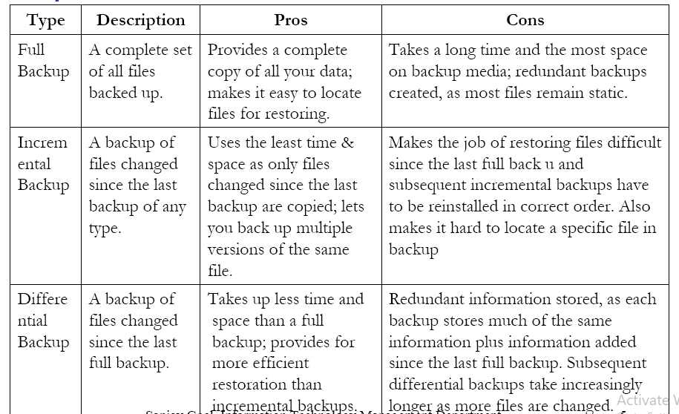
BACKUP TYPES…
GIT 1201

Slide 18
BACKUP OPTIONS
Remote Backup (Cloud Storage): Customers use the internet to access a shared pool of computing resources owned by a cloud service provider
Pros
Protects data against some of the worst-case scenarios,
  natural disasters or critical failures of local devices.
Anytime access to data and applications anywhere.
GIT 1201

Slide 19
REMOTE BACKUP – CLOUD STORAGE
Cons
The cloud’s dependence on the internet can delay communications between you and the cloud
No universal standards, platforms, or languages for cloud computing.
The distribution of cloud data may cause some organizations problems with jurisdiction and fair information practices.
Little or no knowledge of their service provider’s cloud infrastructure or its reliability
GIT 1201

Slide 20
INTERNAL HARD DISK DRIVES
Hard disk drives store data on a spinning magnetic platter read by a moving read/write head.
Pros
Quick update of backup files and
Maintain a simple file structure, all without purchasing any other storage device.
GIT 1201

Slide 21
INTERNAL HARD DISK DRIVES
Cons
Rolling backups can propagate any corruption or malware in the primary files to the backup files.
If the internal hard drive is damaged, stolen, or corrupted, primary and backup files are lost.
The more backup files stored there, the less space the computer has to operate.
GIT 1201

Slide 22
REMOVABLE STORAGE MEDIA
Storage media that can be connected to and disconnected from the computer
They are more versatile backup option than the computer’s internal hard drive.
Separate backups from the computer to keep data safe
  Examples;
  External Hard Disk Drives, flash drives, Optical storage media, such as CDs, DVDs, Magnetic Tape
GIT 1201

Slide 23
REMOVABLE STORAGE MEDIA …
Pros
  Flexible data storage alternative due to portability.
  Available in a wide variety of storage capacities and prices.
  Most removable media are also reusable.
Cons
  More prone to loss or theft.
  Rolling backups may spread corruption and malware from the primary files to the backups.
GIT 1201

Slide 24
SELECTING MEDIA AND DEVICES FOR BACKUP
Capacity: Amount of data that needs to be back up routinely–
  Can the backup hardware support the required load
Reliability: Failure rate of hardware and media –
  Reliability needs to be balanced with cost and time.
Extensibility: The extensibility of the backup solution. –
  The solution needs to be scalable to growing needs of organization
GIT 1201

Slide 25
SELECTING MEDIA AND DEVICES FOR BACKUP…
Speed: The speed at which data can be backed up & recovered. –
  Need to balance cost of down operations versus cost of equipment
Cost: The cost of the backup solution. –
  Does it fit into your budget?
GIT 1201

Slide 26
ON-SITE VS. OFF-SITE
ON-SITE
Advantages:–
  Its under your control
  You know what is happening with the media
  You know it is working
  Good for large data files
Disadvantages–
  Fire means data loss
  If you have an accident while backing up data is lost
  Restoring backups requires
GIT 1201

Slide 27
ON-SITE VS. OFF-SITE…
OFF-SITE
Advantages–
  Saves organization time
  Service Level agreement ensures guaranteed backup
Disadvantages
  No control
  You don't know what they do with your data
  Large data stores can't backed-up
  Network can be expensive
GIT 1201

Slide 28
RETENTION
No single retention period applies to all of any agency’s records
Retention periods are determined by
  the content,
  nature, and
  purpose of records
Data retention period are set based on
  legal, administrative, and historical values, regardless of the format
  business requirements, both operational and strategic
GIT 1201

Slide 29
RETENTION…
The length of time that data is kept by the organization that gathered it
  How long data is kept available.
Retention is directly related to archiving and purging.
As the need for data to be available for use changes it may be appropriate for that data to be archived.
When legal and business requirements no longer apply,
the data is then be purged
Every dataset must have a documented retention schedule
GIT 1201

Slide 30
RETENTION…
It states the time period after which the data will be purged,
Also the conditions under which data will be archived
GIT 1201

Slide 31
ARCHIVING
Moving data from the primary system or database where it was being used
It is the intentional preservation of data in a format that makes it easy for collaborators to refer back to
An archive system is;
  Less accessible than the primary system,
  It has lower levels of performance, and
  Uses cheaper storage.
GIT 1201

Slide 32
ARCHIVING
It should be possible to restore archived data back to the originating system
A key aspect of archiving data is that the data remains available
GIT 1201

Slide 33
PURGING
The process of completely removing data from storage media such that it cannot be recovered.
It the process of deleting data in a safe and responsible manner
Data to be purged is deemed obsolete and unnecessary, even for regulatory purposes.
After purging, data is no longer available to access or use
It cannot be recovered or restored.
GIT 1201

Slide 34
PURGING…
Purging may also be referred to as;
  removal,
  deletion, or
  destruction
Records contain personal and confidential information
They must be destroyed securely after they have reached the end of their retention period.
Electronic copies must be securely deleted,
Hard copies disposed of as confidential waste.
GIT 1201

Slide 35
PURGING…
All records containing personal information should be shredded before disposal.
GIT 1201

Slide 36
WHY GET RID OF DATA
Reduces the risk of it leaking or being accessed by adversaries
Ensure that data is accurate,
Appropriately respond to requests from users
GIT 1201

Slide 37
CREATE A RETENTION, ARCHIVAL AND DISPOSAL (RAD) PLAN
A RAD plan is a systemic way to manage program data.
RAD plans can be customized for different situations.
In general, all RAD plans should describe:
  The types of data the organization must retain (and why)
  The length of time the data should be stored (and why)
  The format in which such data should be stored (and why)
  How the data will be retained, archived, transferred and destroyed
GIT 1201

Slide 38
CREATE A RETENTION, ARCHIVAL AND DISPOSAL (RAD) PLAN…
  Who is authorized to delete data
  Who is covered by the plan and team member roles/responsibilities
  The penalties resulting from plan violations
GIT 1201

Slide 39
RECOVERING DATA
Data needs to be recovered for many reasons.
The most common is human error, such as
  accidentally deleting an email or
  copying an old version of a file over the new version.
  Viruses and other malware
  No one can remember where it was fi led.
Data recovery is how you get your data back,
GIT 1201

Slide 40
RECOVERING DATA…
Recovery is more complicated if an entire system becomes corrupted
With a tested recovery plan, the task of recovery is far from impossible.
Although most recovery actions are related to user mistakes that involve only a file or two,
A full system restore may be necessary.
GIT 1201

